Slide 1
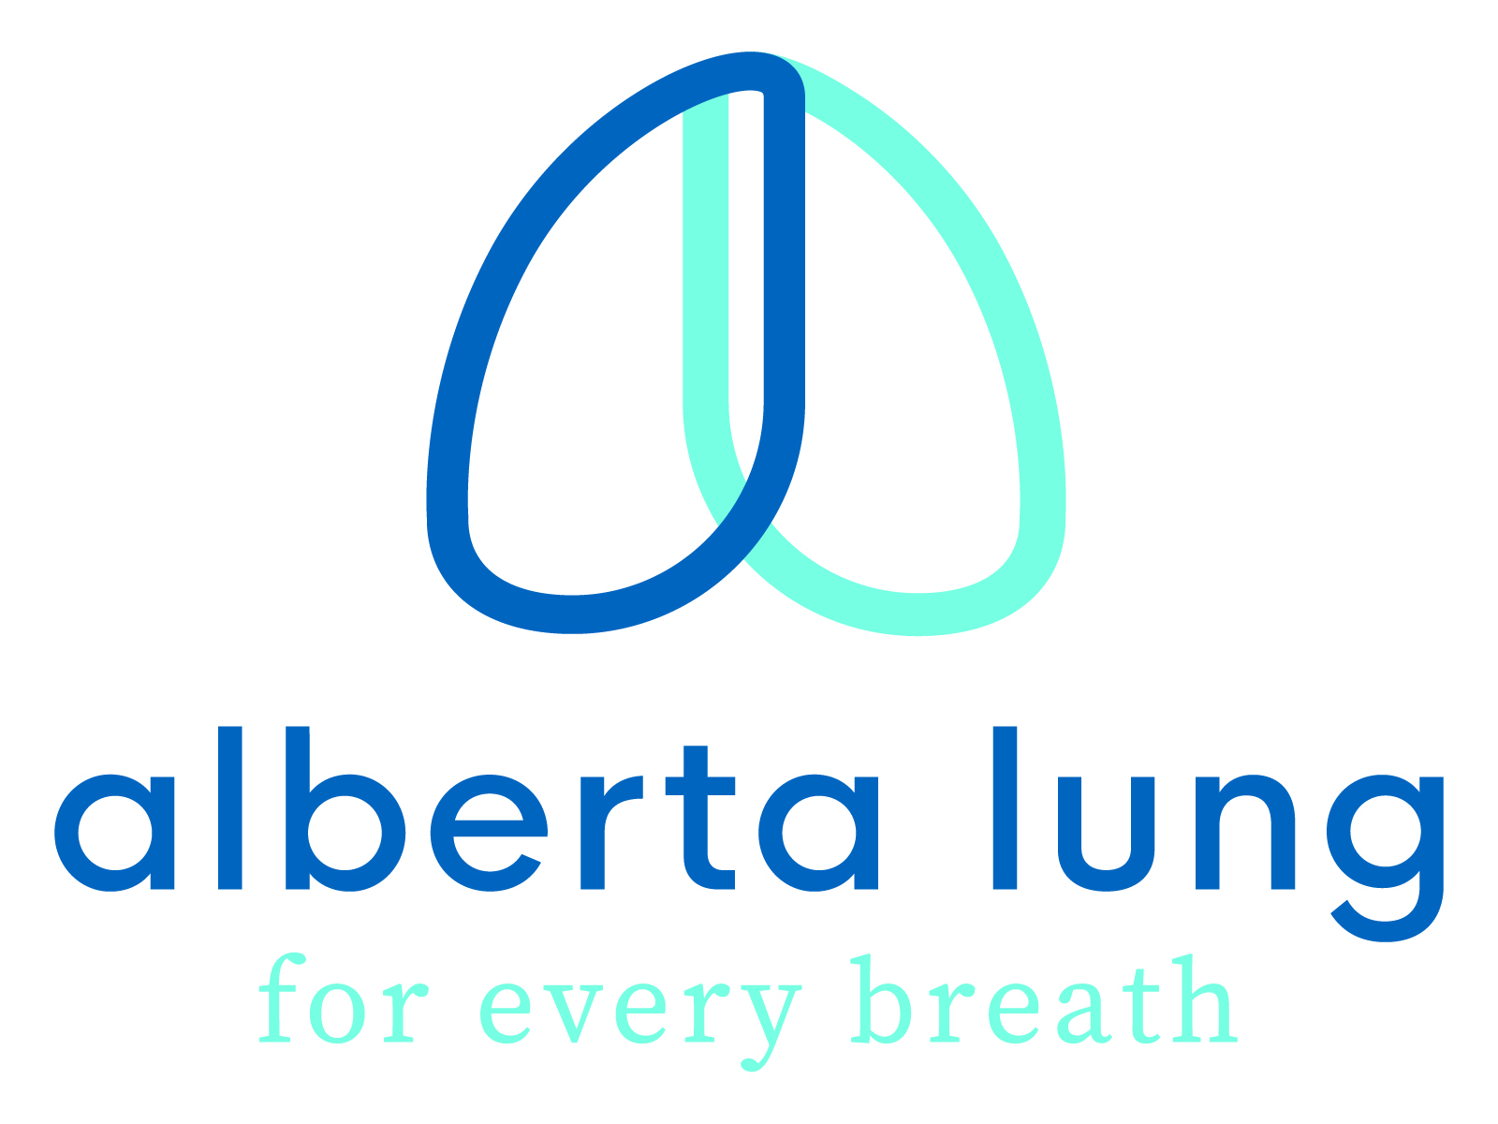
HEALTHY AIR AWARE
The Impact of Wildfire Season, Poor Air Quality on Health
And
Tools to Protect Yourself
Jamie Happy
Health Promotion Coordinator
Alberta Lung

Slide 2
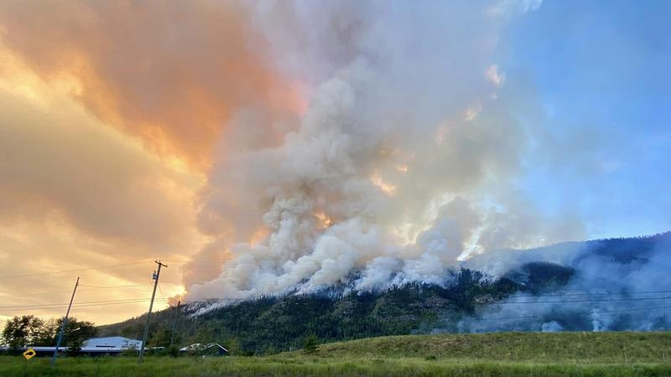
BACKGROUND
Alberta Lung is a provincial health non-profit that serves the public as well as the 1 in 5 Albertans directly affected by over 40 distinct lung diseases and their families. Our focus is research support, advocacy, patient assistance and education, like this webinar in partnership with the West Central Airshed Society
2023 was a record-breaking year for wildfires globally. 5% of Canada’s forests burned and 6.6% of Alberta’s forest burned (32,000 sq. km or the size of Vancouver Island). We also broke records with the number of smoke hours and air quality events (situations like a wildfire that causes bad air quality) across the province- from Fort McMurray all the way to Lethbridge. For example, Calgary had over 20 times its average number of smoke hours.

Slide 3
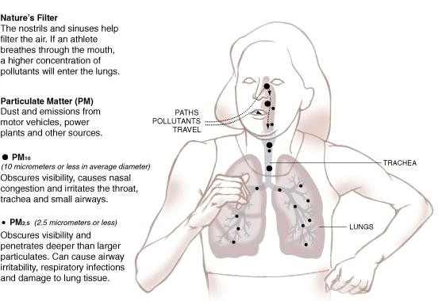
AIR QUALITY
Wildfire smoke impacts us indoors and outdoors. It is made up of a complex combination of chemicals like volatile organic compounds, ozone, carcinogens from burned wood, plastic, building material, etc. Industrial/vehicle pollution and cooking fumes can also contribute to poor air quality. Particulate matter, or PM, is an air pollutant that consists of both solid, as well as liquid parts, suspended in air.
PM2.5 (less than 2.5 micrometres, over 30x smaller than a strand of human hair) is of special concern. These particles are so small that they get deep into our respiratory tract and bloodstream. High PM2.5 is why the air quality can be bad, even when it looks clear outside. Wildfires can produce PM2.5 of 300-500 micrograms per cubic meter. Ther

Slide 4
WHO IS AT RISK?
While poor air quality affects us all, certain populations are especially at risk:
Persons with pre-existing health conditions- especially heart and lung conditions like asthma, COPD and high blood pressure.
Seniors
Infants and young children
Pregnant women
The unhoused or those that work outside are also at risk due to increased exposure.

Slide 5
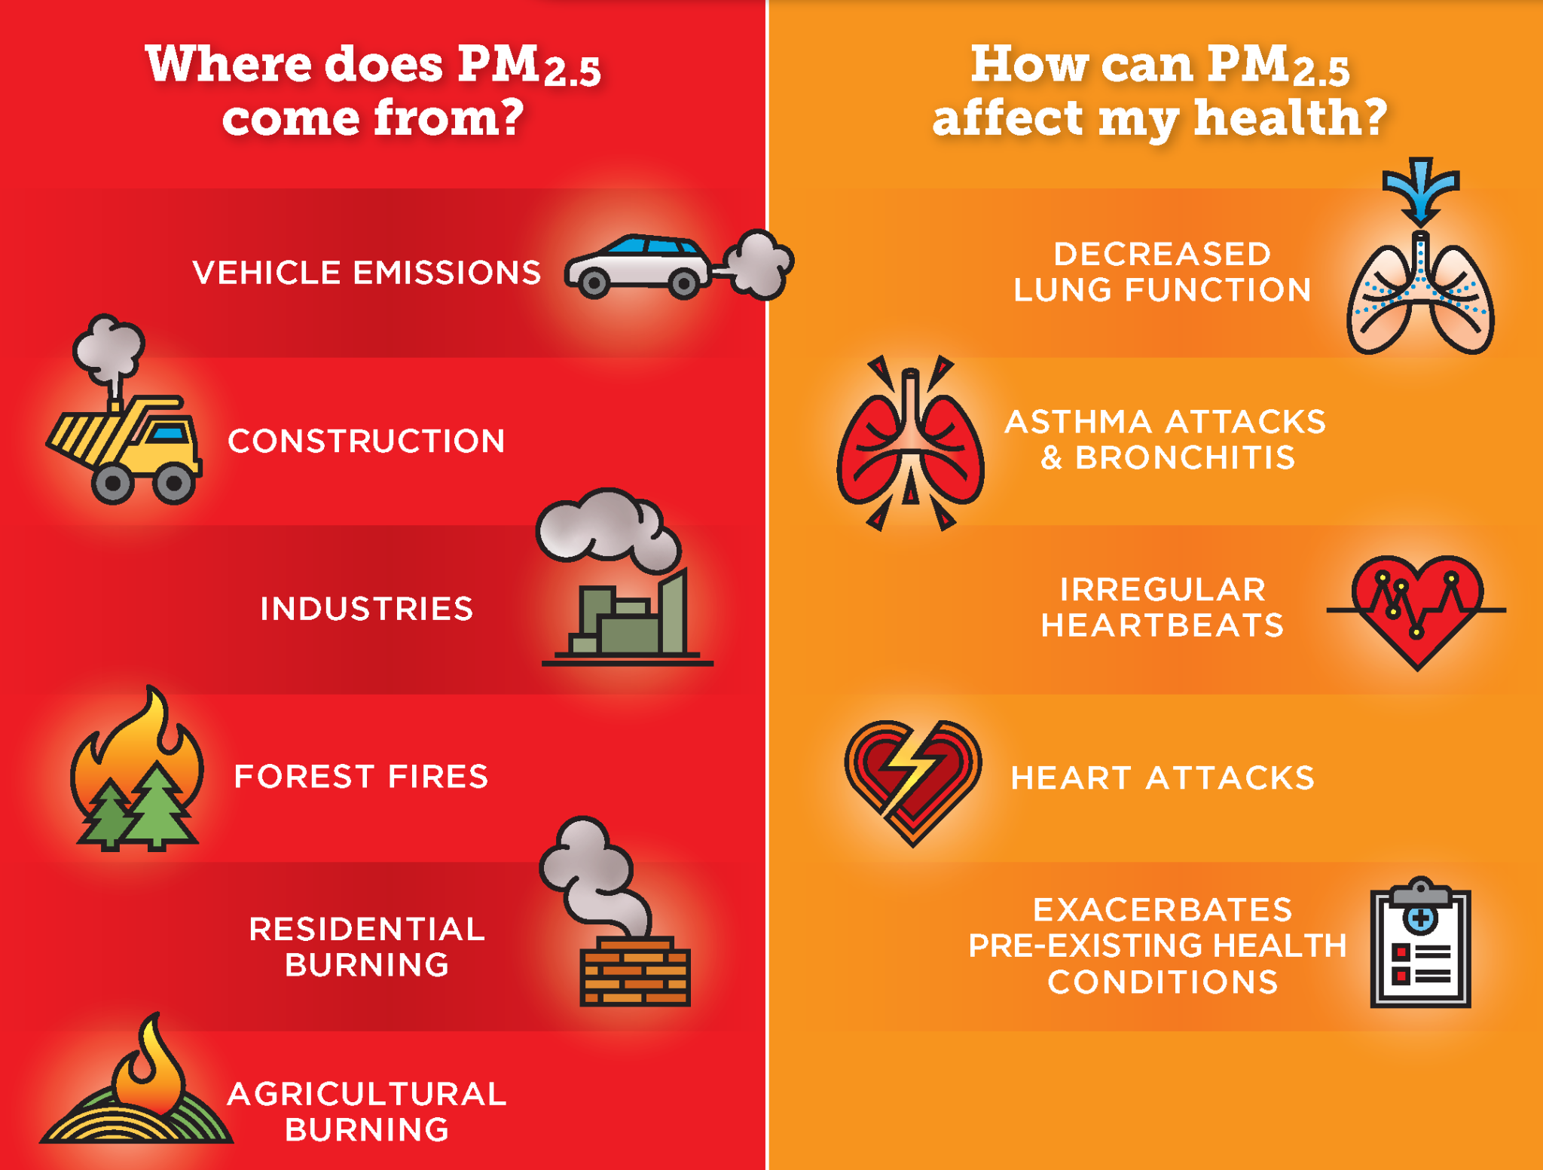
PM2.5, smoke and other pollutants are linked to poorer overall health long-term.
SHORT-TERM
Irritated eyes
Headaches
Coughs and sore throats
Shortness of breath and/or difficulty breathing
If you experience symptoms that are disruptive, seek medical attention. If you are having breathing difficulty, seek emergency medical care immediately

Slide 7
LONG-TERM
Poorer overall health and lowered immunity. Increased risk of heart attack and stroke.
Decreased lung function
Increased risk of complications like low birth weight or premature birth in pregnant women
Increased risk of lung disease and heart disease like chronic bronchitis
If you have a lung disease, it increases risk of a severe reaction and long-term side effects

Slide 8
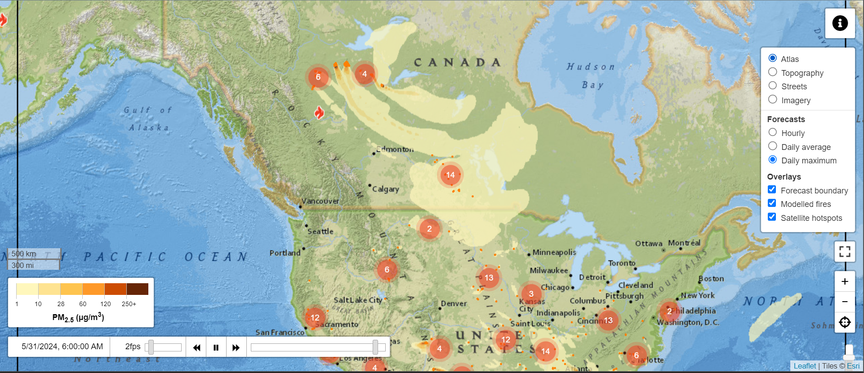
TOOLS TO STAY INFORMED
Use tools like the FireSmoke.ca which forecasts smoke patterns to plan your day and Air Quality Health Index which measures common air pollutants (PM 2.5, nitrogen oxide and ozone).
https://firesmoke.ca/forecasts/current/
Use this handy tool to check forecasted smoke patterns hourly and daily. As seen last year, smoke can travel quickly and far- poor air quality in Europe was linked to Canadian wildfires.
Use this as a guide, conditions can change quickly.

Slide 9
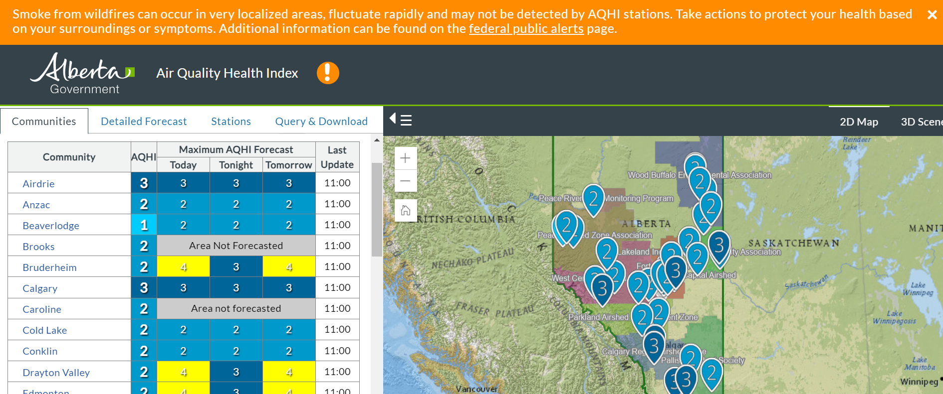
https://airquality.alberta.ca/map/
https://www.wcas.ca/resources/air-quality-and-your-health/
Use this tool to check current and forecasted air quality levels in your community and plan accordingly. Keep an eye out for Air Quality Alerts which warn of poor air quality for all populations. Predictions are made using real-time data from monitoring stations and computer modeling. A guide to using the AQHI can be found on the West Central Airshed Society.

Slide 10
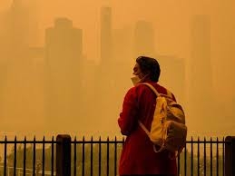
PRECAUTIONS
Stay hydrated to keep your mouth and nose moist.
Close windows and doors. If you have an air conditioner, close the fresh-air intake so it doesn’t bring smoky air inside. When driving, close windows and vents.
Exercise indoors, limit exposure outdoors. If you need to be outside, keep it short and wear a mask (a well-fitted respirator type mask (such as a NIOSH certified N95 or equivalent respirator) or one that does not allow air to pass through small openings between the mask and face can help reduce your exposure to the fine particles in smoke).
Check your home’s vents, windows, etc. Ensure your indoor air quality is good. Limit cooking fumes, excess use of scented sprays, etc.

Slide 11
If you or someone in your household has a lung disease, change your clothes when going from outdoors to indoors, to avoid spreading particles that can be a lung irritant inside the home.
If you have a lung disease, keep your medications handy. Talk to your doctor if your symptoms worsen.
Poor air quality can affect pets and livestock too. Animals, especially flat faced cats and dogs, can struggle just like humans. Take your dog to an indoor pet friendly store or play area. Talk to your vet if your pet experiences discomfort.
Develop a plan B when poor air quality cancels or limits outdoor activities. Can’t play soccer outside? Head to the rec centre for an indoor swim. Have a box of games, crafts, etc. ready just in case.
Festivals, outdoor markets, sport events, etc. should have a plan in place to move indoors if air quality conditions worsen. Municipalities can open buildings to the public to take breaks from poor air. If you or your household has outdoor activities planned, like youth soccer, talk to the organizers about a plan B to move indoors or back up activity.
Check the AQHI and plan accordingly.

Slide 12
DIY Air Purifier
If you are spending time indoors due to poor air quality events, you want to be sure your indoor air is good! Air purifiers don’t have to be expensive or complicated. Here is a budget friendly model that meets Health Canada recommendations that picks up fine particles like smoke residue. Estimated cost is under $150-$175 (depending on box fan model, number of filters, etc.). Filters should be changed every 4-8 months or when it is noticeably dirty. Instructions can be found at ablung.ca/lung-health-/air-quality/diy-air-cleaner/
A University of California study showed the Corsi-Rosenthal model performs similar to store-bought, residential air cleaners and costs almost three times less.
MATERIALS
20x20x1” Furnace filter (1 for a single filter purifier, 4 for a Corsi-Rosenthal box which is more effective) with a MERV (Minimum Efficiency Reporting Value) of 13 (MPR 1900). Captures approx. Minimum 80% of PM2.5.
20” Box Fan with 75-100 watts for good airflow and adjustable power settings.
Duct Tape
Ruler
Scissors
Cardboard (from fan box)

Slide 13
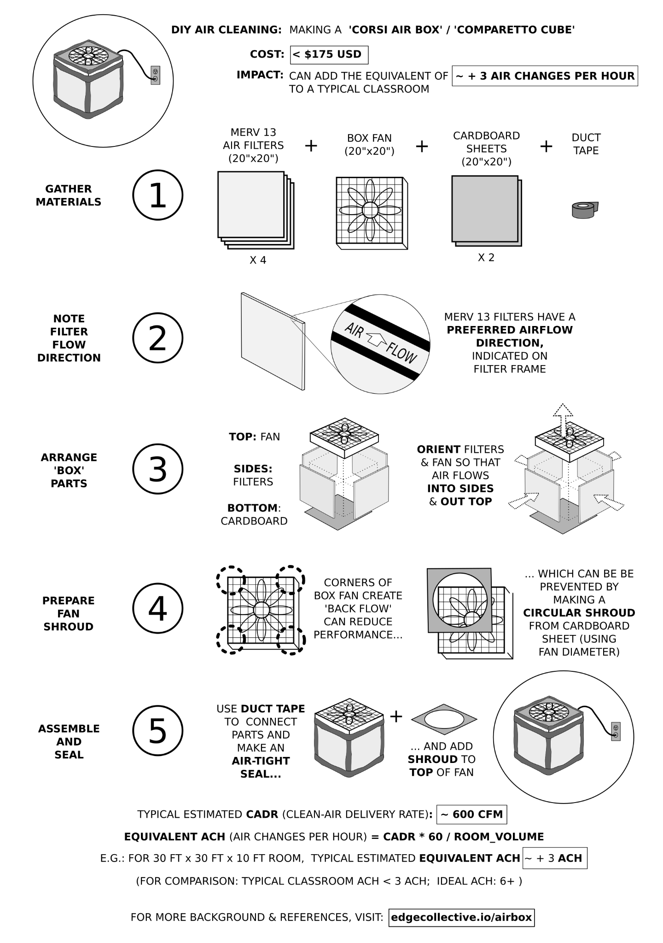
Watch a how-to from the Pacific Institute on Pathogens, Pandemics and Society.
https://www.youtube.com/watch?v=oo2n9J2AJk0
NOTE:
DIY Air purifiers are not designed for cooling. Air cleaner should be used with at least 4 feet of space away from walls, curtains or furniture. Place on a hard surface (not carpet).
If noise is a concern, keep it on medium power. If power use is a concern, look into battery powered.
Notes:
https://www.youtube.com/shorts/z1wXYwvgrFc

Slide 14
Notes:
https://www.youtube.com/shorts/z1wXYwvgrFc

Slide 15
AQHI | Health Risk | Population | Health | Messaging
 |  | At Risk (young children, elderly, pregnant, pre-existing health conditions-especially lung disease) | General Public | Schools and Daycares | Outdoor Workers
1-3 | Low | Ideal air quality, usual outdoor activities. No precaution needed. | See At Risk Outdoor Soccer | See At Risk | See At Risk
4-6 | Moderate | Consider reducing, shortening or rescheduling strenuous activity-especially if experiencing symptoms. Wear a mask when outdoors. | No need to modify activity unless experiencing symptoms/ Outdoor Soccer (indoor practice or shortened game) | Consider reducing or rescheduling strenuous activity. Have an indoor activity and space for at risk staff and children. | No need to modify activity unless experiencing symptoms. Wear a mask/face covering and stay hydrated.
7-10 | High | Reduce or reschedule strenuous activity , especially if experiencing symptoms. Wear a mask when outdoors. | Consider reducing, shortening or rescheduling strenuous activity-especially if experiencing symptoms. Indoor Soccer | Reduce or reschedule outdoor activity for staff and children. Have an indoor activity and space for at risk staff and children. | Wear a mask/face covering, stay hydrated and take frequent indoor breaks. Consider limiting strenuous outdoor activity and stay hydrated.
Over 10 | Very High | Avoid or limit time outdoors, reschedule outdoor activities. Wear a mask when outdoors. | See At Risk | See At Risk | Wear a mask/face covering, stay hydrated and take frequent indoor breaks. Limit outdoor exposure as much as possible and stay hydrated. Consider indoor work for at risk staff.

Slide 16
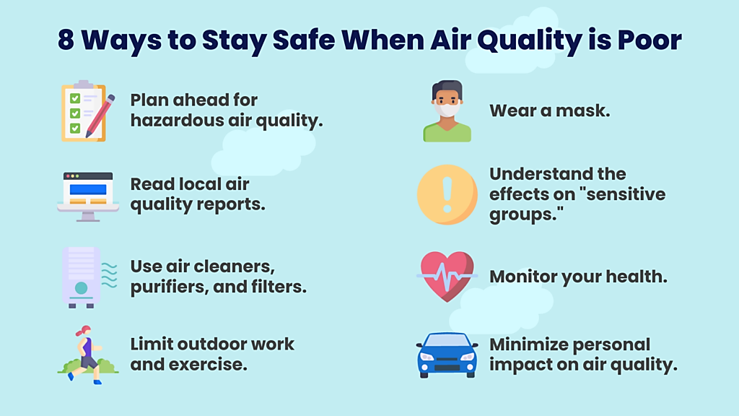

Slide 17
TITLE SLIDE
THANK YOU!

