Slide 1
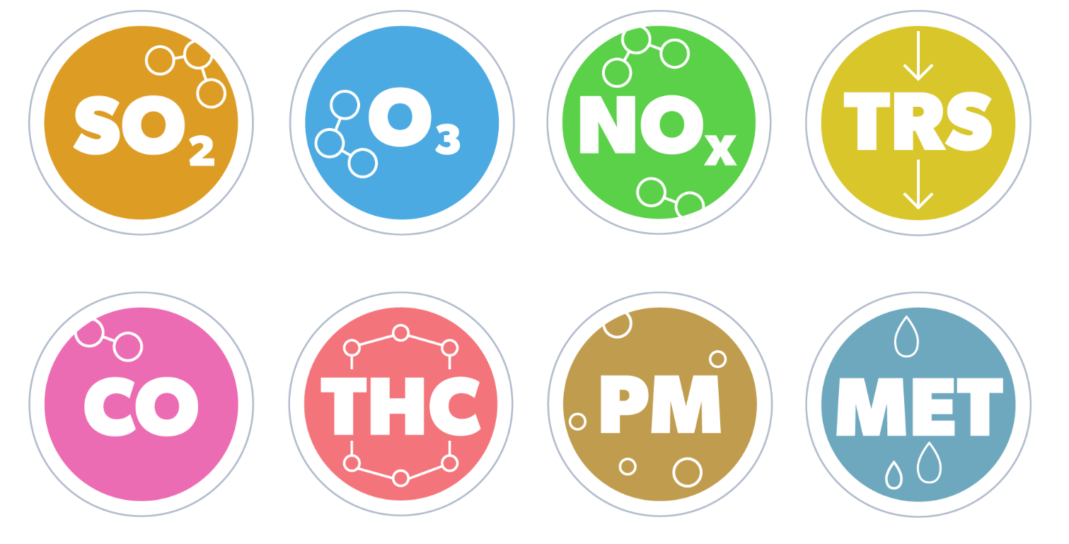
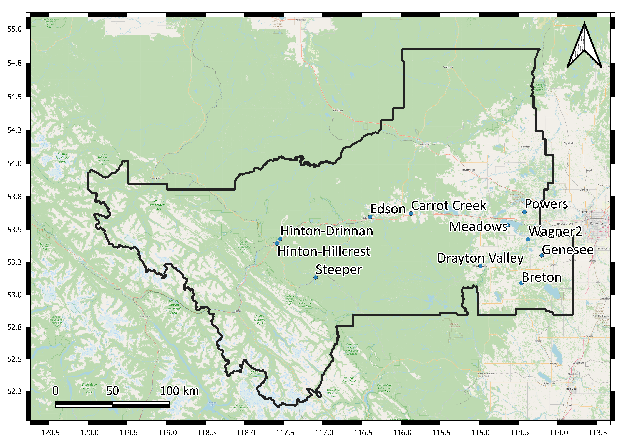
Data Insights with Dr. Kev
May 29, 2024

Slide 3
Air Quality 2022-2023
Readings above the AAAQO and AAAQG in 2022
SO₂ hour 172ppb | SO₂ day 48ppb | SO₂ month 11ppb | H₂S hour 10ppb | H₂S day 3ppb | NO₂ hour 159ppb | O₃ hour 76ppb | PM_{2.5} hour 80µg/m³ | PM_{2.5} day 29µg/m³ | CO hour 13ppm | CO 8-hour 5ppm
0 | 0 | 0 | 67 | 10 | 0 | 0 | 54 | 23 | 0 | 0
Readings above the AAAQO and AAAQG in 2023
SO₂ hour 172ppb | SO₂ day 48ppb | SO₂ month 11ppb | H₂S hour 10ppb | H₂S day 3ppb | NO₂ hour 159ppb | O₃ hour 76ppb | PM_{2.5} hour 80µg/m³ | PM_{2.5} day 29µg/m³ | CO hour 13ppm | CO 8-hour 5ppm
0 | 0 | 0 | 9 | 1 | 0 | 108 | 1252 | 205 | 0 | 2
Operational times less than 90 percent in 2023:
Steeper station was shut down in June 2023 due to fires near transformers and lines <90% (77% uptime)
Hinton-Drinnan, July 2023, TRS <90% (84% uptime) due to maintenance on analyzer

Slide 4
 | Breton | Carrot Creek | Drayton Valley | Edson | Genesee | Hinton-Drinnan | Hinton-Hillcrest | Meadows | Powers | Steeper | Wagner2
 | N=8760 | N=8760 | N=8760 | N=8760 | N=8760 | N=8760 | N=8760 | N=8760 | N=8760 | N=8760 | N=8760
SO₂ | 0.3 (95%) | 0.1 (95%) | 0.2 (95%) | 0.3 (94%) | 0.5 (95%) | 0.5 (95%) | 0.2 (94%) | 0.3 (94%) | 0.3 (95%) | 0.1 (93%) | 0.3 (94%)
NO | 0.6 (94%) | 1.4 (95%) | 3.2 (95%) | 3.5 (94%) | 0.6 (95%) | 4.4 (95%) | 1.5 (94%) | 0.5 (95%) | 0.4 (95%) | 0.1 (93%) | 1.8 (94%)
NO₂ | 3.3 (94%) | 4.7 (95%) | 8.4 (95%) | 6.9 (94%) | 4.1 (95%) | 6.7 (95%) | 3.9 (94%) | 3.5 (95%) | 3.2 (95%) | 1.0 (93%) | 4.0 (94%)
NO_{X} | 3.9 (94%) | 6.1 (95%) | 11.6 (95%) | 10.4 (94%) | 4.7 (95%) | 11.0 (95%) | 5.4 (94%) | 4.0 (95%) | 3.6 (95%) | 1.1 (93%) | 5.8 (94%)
O₃ | 30.5 (94%) | 26.7 (95%) | 29.1 (94%) | 25.7 (94%) | 32.0 (95%) | 23.4 (95%) | 31.4 (94%) |  |  | 38.1 (93%)
PM_{2.5} |  |  | 13.9 (100%) | 13.8 (99%) | 13.0 (100%) | 12.9 (99%) | 10.9 (98%) |  | 13.1 (99%) | 8.0 (98%)
RH | 65.1 (100%) | 69.5 (100%) | 59.9 (100%) | 67.9 (100%) | 65.4 (100%) | 64.0 (100%) | 59.3 (99%) | 65.9 (100%) | 68.6 (100%) | 61.1 (100%) | 71.2 (99%)
ET | 5.3 (100%) | 4.7 (100%) | 5.9 (100%) | 5.1 (100%) | 8.1 (100%) | 6.6 (100%) | 6.4 (99%) | 6.0 (100%) | 6.2 (100%) | 4.6 (100%) | 5.3 (99%)
H₂S |  |  |  |  |  | 0.4 (95%)
TRS |  |  |  |  |  | 0.6 (93%) | 0.3 (94%)
CO |  |  |  |  |  |  |  |  |  | 0.2 (93%)
Notes:
SO2 highest recorded hour measured at 48ppb (172ppb) and highest recorded 24-hour average at 9.6ppb (48ppb)
NO2 highest recorded hour measured at 58 ppb (159ppb) and highest recorded 24-hour average at 28ppb (no limit)
O3 highest recorded hour measured at 94 ppb (76ppb) and highest recorded 24-hour average at 64 ppb (no limit).
PM2.5 highest recorded hour measured at 1,136µg/m³, with the highest recorded 24-hour measured at 408µg/m³

Slide 5
Additional Highlights
SO₂ annual averages were <0.5 ppb, which is slightly less than previous years at <0.7ppb
NO₂ annual averages over the past three years were similar in range 1.0 to 8.4ppb (2021, 0.9 to 7.9 ppb; 2022, 1.0 to 8.0 ppb)
O₃ was impacted by the large number of wildfires in 2023 which resulted in the significant increase of readings above the AAAQO limits. Annual averages ranged from 23.4 to 38.1 ppb, in past two years the highest average was 36.1ppb and 35.8ppb.
PM_{2.5} resulted in 1457 alarms, compared to previous years 77 in 2022 and 255 in 2021.
CO resulted in two readings above the eight-hour AAAQO limit (5ppm). Elevated readings of CO were influenced by the wildfire smoke, the overall average annual has remained at 0.2ppm for last three years.
Annual averages for H₂S and TRS dropped by half to ~0.5 ppb, compared to previous years of 2021 to 2022 when annual average was 0.8 to 1.1 ppb
In 2023, the warmest hourly period was recorded at 36.7°C (37.7°C, 2022) and coldest hourly period at -37.5°C (-39.7°C*, 2022).
Notes:
* Equipment only reads to -40
Temperatures were above 20°C for 9,232 hours, and below -20°C for 5,731 hours of the data collected.
Temperatures were above 20°C for 10,307 hours, and below -20°C for 971 hours of the data collected.

Slide 6
Annual General Meeting – Data Highlights
Duel Virtual Servers running at 100%, with data backups daily
Continue to have information geocoded to have as much information into GIS layers and be map ready
Active scripting to bring interactive data to all stakeholders
Annual Review
Short Monthly Review
Detailed Monthly Review
Detailed Monthly Review with Individual Stations
Sensor Review
Investigation dashboards and special reviews

Slide 7
Highlights from 2023 Monitoring
We are going to focus on ozone and particulate
We are going to highlight work on nitrogen and sulphur

Slide 8
2023

Slide 9
2023

Slide 10
Wildfire smoke impacts 2023
From all monitoring in the province last year a total of 648240 hours of PM_{2.5} was collected
19,873 hours were above the 1hr objective (80µg/m³)
Notes:
This equates to 3% of the time monitoring we were above the objective limit

Slide 11
2023 – Hinton-Hillcrest

Slide 12
2023 – Hinton-Drinnan

Slide 13
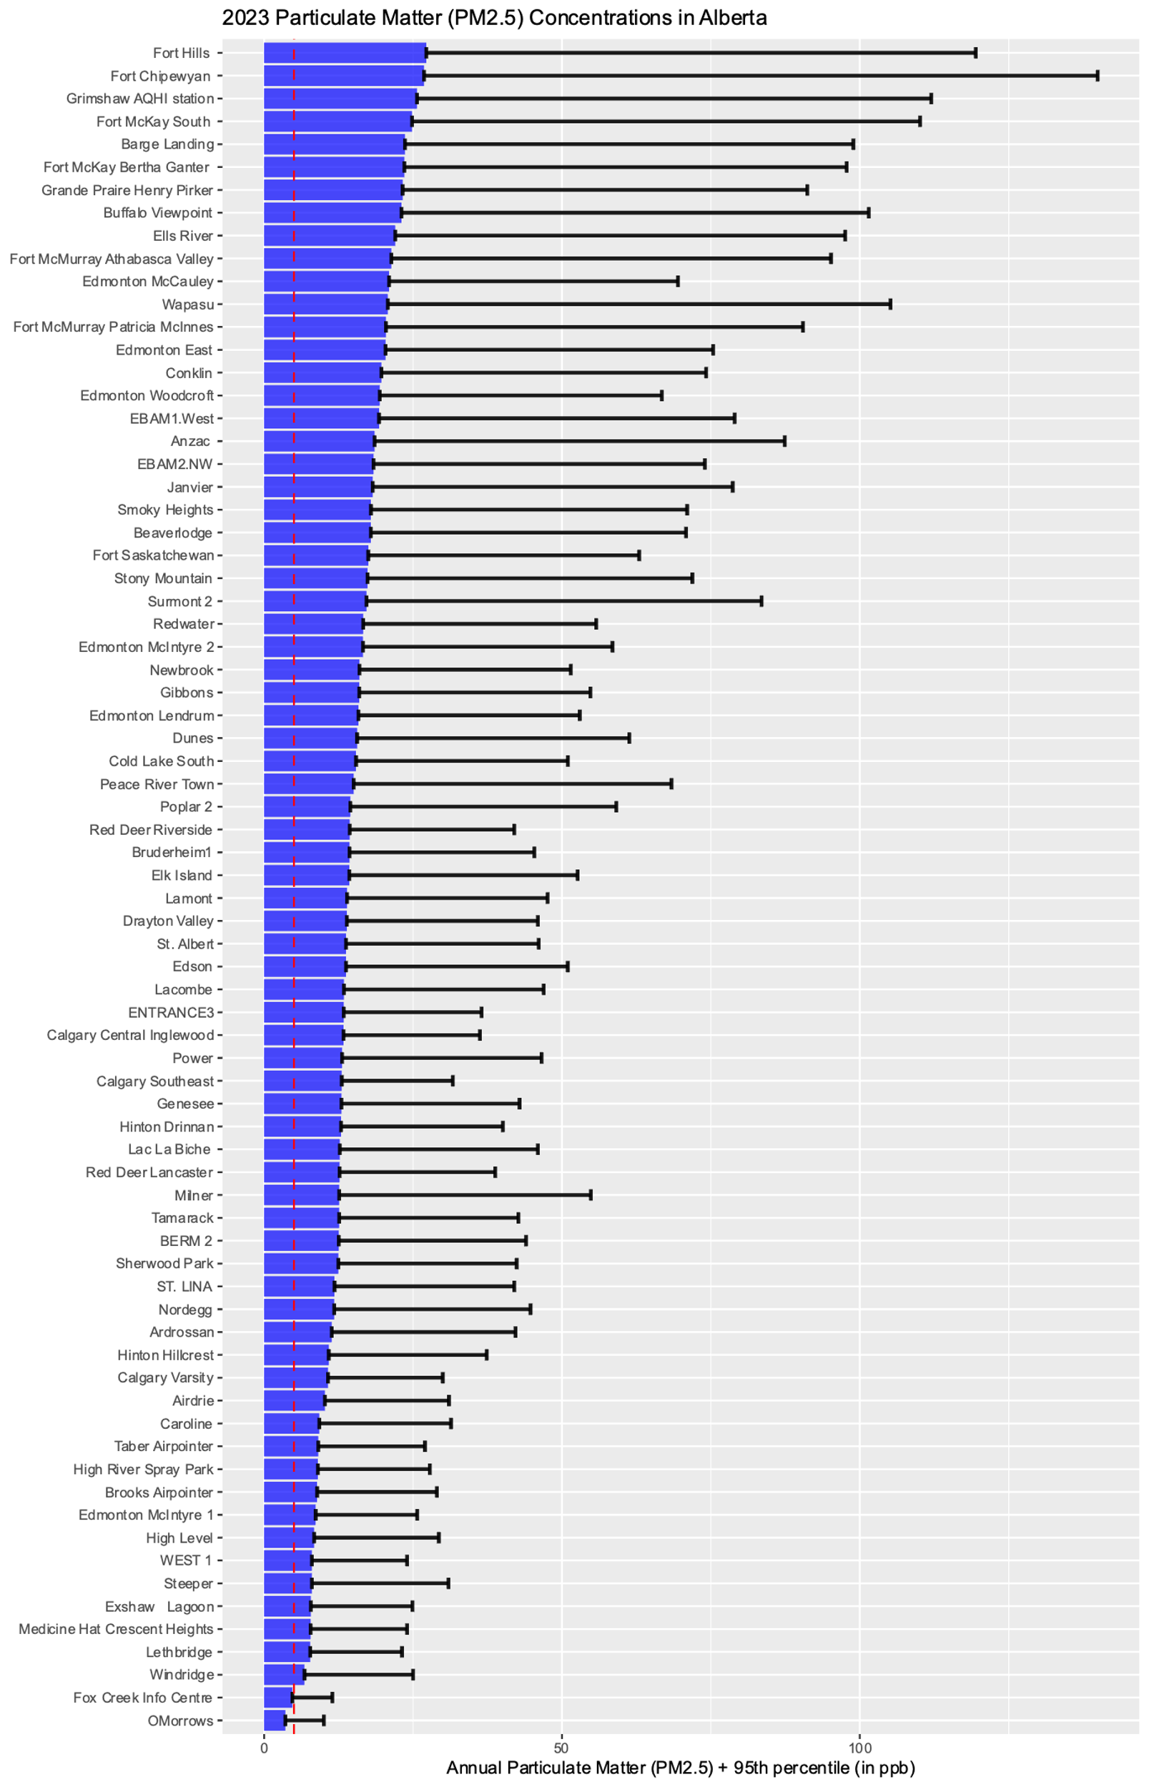
All Provincial PM_{2.5} Monitoring
Hinton Drinnan
Average PM_{2.5},
12.9µg/m³
Hinton Hillcrest
Average PM_{2.5},
10.9µg/m³
Notes:
PM2.5 monitoring occurred at 74 total stations in the province
For interest sake the WHO recommends PM2.5 not exceed 5 ug/m3
Both stations had the maximum occur on May 18 (24hr) and May 20 (1hr)
HintonD = 379 (1hr), 211 (24hr)
HintonH = 429 (1hr), 203 (24hr)

Slide 14
Sulphur and Nitrogen reviews

Slide 15
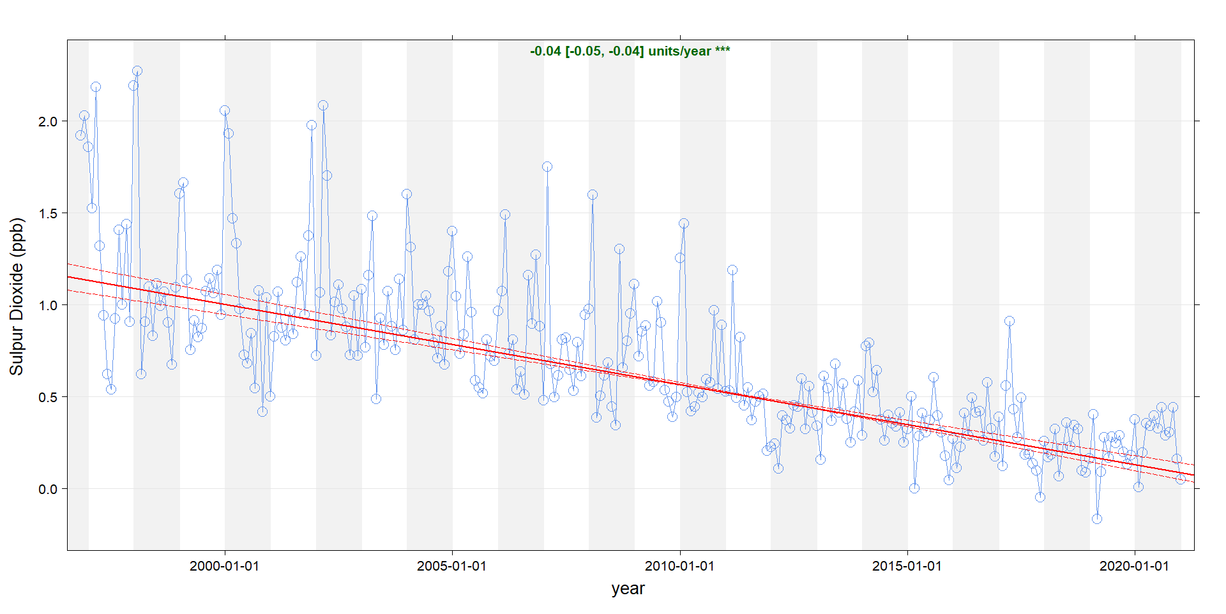

Slide 16
Summary Wrap-up
Web Resources for checking…
Weather and air quality checks:
WeatherCAN app
https://www.windy.com/?50.470,-104.540,5
https://www.wcas.ca/
Fire information:
https://www.arcgis.com/apps/dashboards/bf5df3a49a624521844a2e5e1ec7df05
https://firesmoke.ca/forecasts/current/

Slide 17
Satellite Resources …
https://zoom.earth/maps/satellite/
https://www.nesdis.noaa.gov/imagery/interactive-maps/the-world-real-time
https://worldview.earthdata.nasa.gov/
https://earthnow.usgs.gov/observer/
https://www.ventusky.com/
Copernicus Browser
Notes:
https://www.youtube.com/watch?v=_HGQZlK08gQ

